Slide 1

Micro Credit Loan Defaulters
By:
Vinayak Ratan

Slide 2
Business Problem
MFI to provide micro-credit on mobile balances to be paid back in 5 days. The Consumer is believed to be defaulter if he deviates from the path of paying back the loaned amount within the time duration of 5 days. For the loan amount of 5 (in Indonesian Rupiah), payback amount should be 6 (in Indonesian Rupiah), while, for the loan amount of 10 (in Indonesian Rupiah), the payback amount should be 12 (in Indonesian Rupiah).
The sample data is provided to us from our client database. It is hereby given to you for this exercise. In order to improve the selection of customers for the credit, the client wants some predictions that could help them in further investment and improvement in selection of customers.
Build a model which can be used to predict in terms of a probability for each loan transaction, whether the customer will be paying back the loaned amount within 5 days of insurance of loan. In this case, Label ‘1’ indicates that the loan has been payed i.e. Non- defaulter, while, Label ‘0’ indicates that the loan has not been payed i.e. defaulter.

Slide 3
Data Description
Variable | Definition
label | Flag indicating whether the user paid back the credit amount within 5 days of issuing the loan{1:success, 0:failure}
msisdn | mobile number of user
aon | age on cellular network in days
daily_decr30 | Daily amount spent from main account, averaged over last 30 days (in Indonesian Rupiah)
daily_decr90 | Daily amount spent from main account, averaged over last 90 days (in Indonesian Rupiah)
rental30 | Average main account balance over last 30 days
rental90 | Average main account balance over last 90 days
last_rech_date_ma | Number of days till last recharge of main account
last_rech_date_da | Number of days till last recharge of data account
last_rech_amt_ma | Amount of last recharge of main account (in Indonesian Rupiah)
cnt_ma_rech30 | Number of times main account got recharged in last 30 days
fr_ma_rech30 | Frequency of main account recharged in last 30 days
sumamnt_ma_rech30 | Total amount of recharge in main account over last 30 days (in Indonesian Rupiah)
medianamnt_ma_rech30 | Median of amount of recharges done in main account over last 30 days at user level (in Indonesian Rupiah)
medianmarechprebal30 | Median of main account balance just before recharge in last 30 days at user level (in Indonesian Rupiah)
cnt_ma_rech90 | Number of times main account got recharged in last 90 days
fr_ma_rech90 | Frequency of main account recharged in last 90 days
sumamnt_ma_rech90 | Total amount of recharge in main account over last 90 days (in Indonasian Rupiah)
medianamnt_ma_rech90 | Median of amount of recharges done in main account over last 90 days at user level (in Indonasian Rupiah)
medianmarechprebal90 | Median of main account balance just before recharge in last 90 days at user level (in Indonasian Rupiah)
cnt_da_rech30 | Number of times data account got recharged in last 30 days
fr_da_rech30 | Frequency of data account recharged in last 30 days
cnt_da_rech90 | Number of times data account got recharged in last 90 days
fr_da_rech90 | Frequency of data account recharged in last 90 days
cnt_loans30 | Number of loans taken by user in last 30 days
amnt_loans30 | Total amount of loans taken by user in last 30 days
maxamnt_loans30 | maximum amount of loan taken by the user in last 30 days
medianamnt_loans30 | Median of amounts of loan taken by the user in last 30 days
cnt_loans90 | Number of loans taken by user in last 90 days
amnt_loans90 | Total amount of loans taken by user in last 90 days
maxamnt_loans90 | maximum amount of loan taken by the user in last 90 days
medianamnt_loans90 | Median of amounts of loan taken by the user in last 90 days
payback30 | Average payback time in days over last 30 days
payback90 | Average payback time in days over last 90 days
pcircle | telecom circle
pdate | date

Slide 4
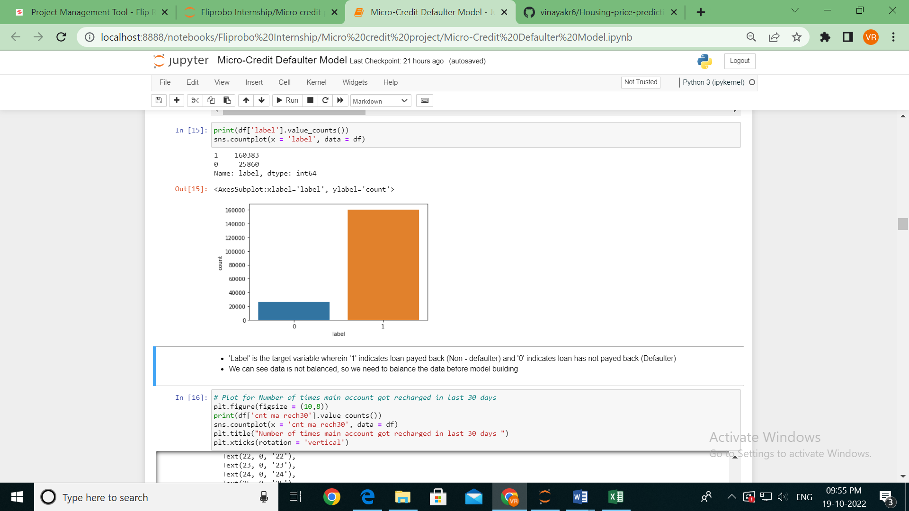
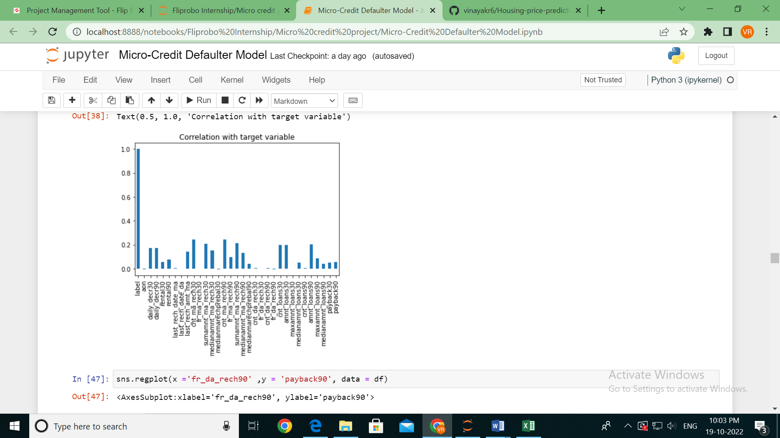
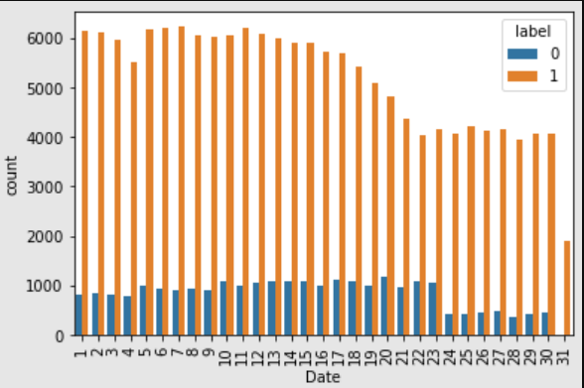
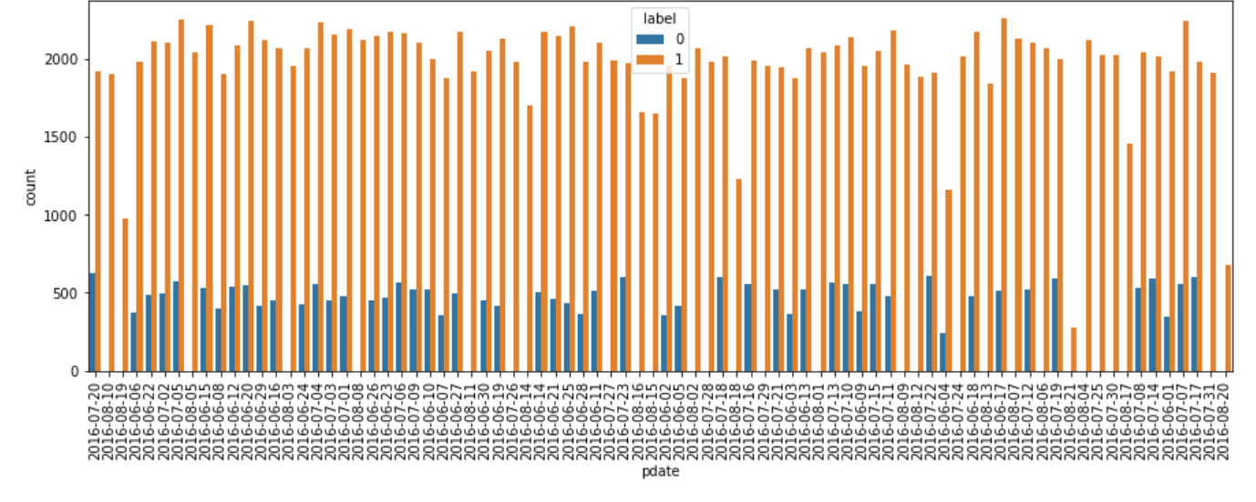

Slide 5
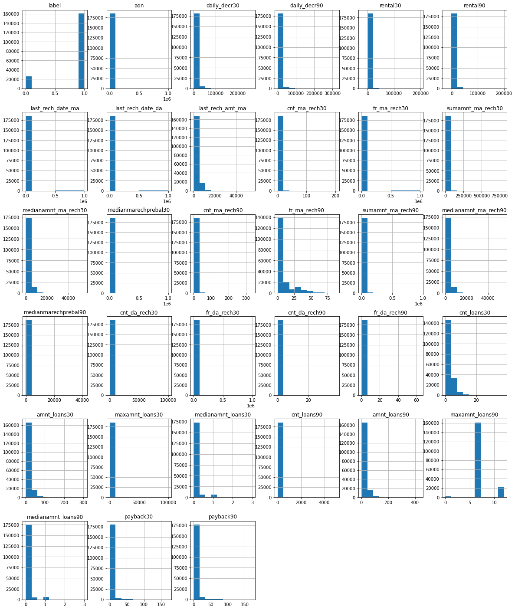
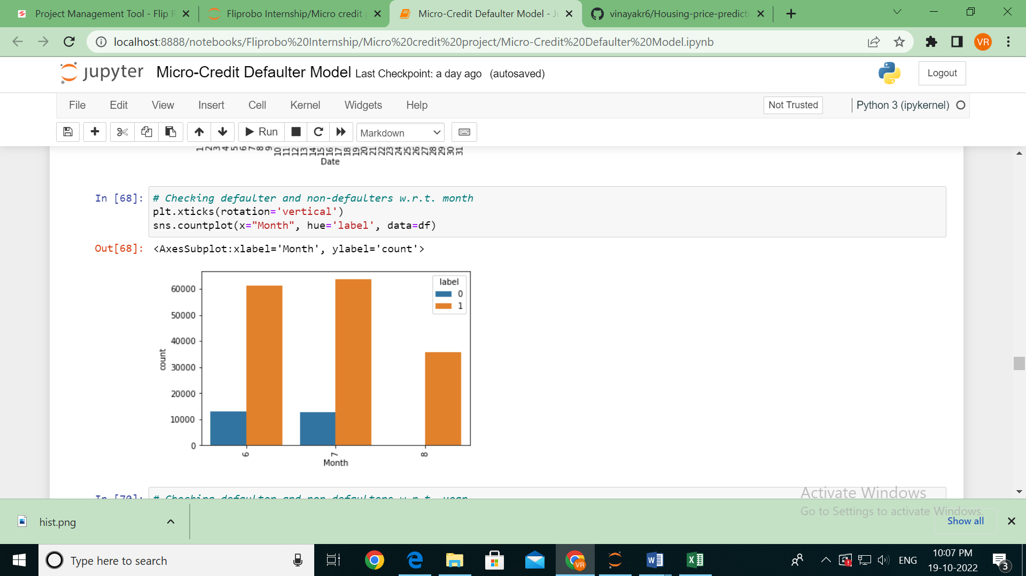
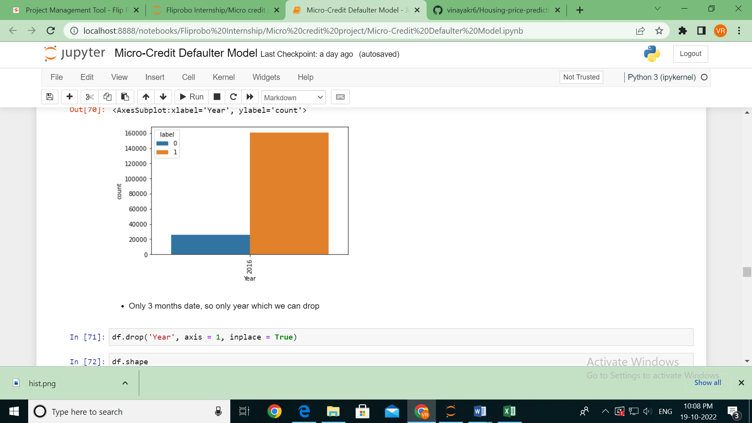

Slide 6
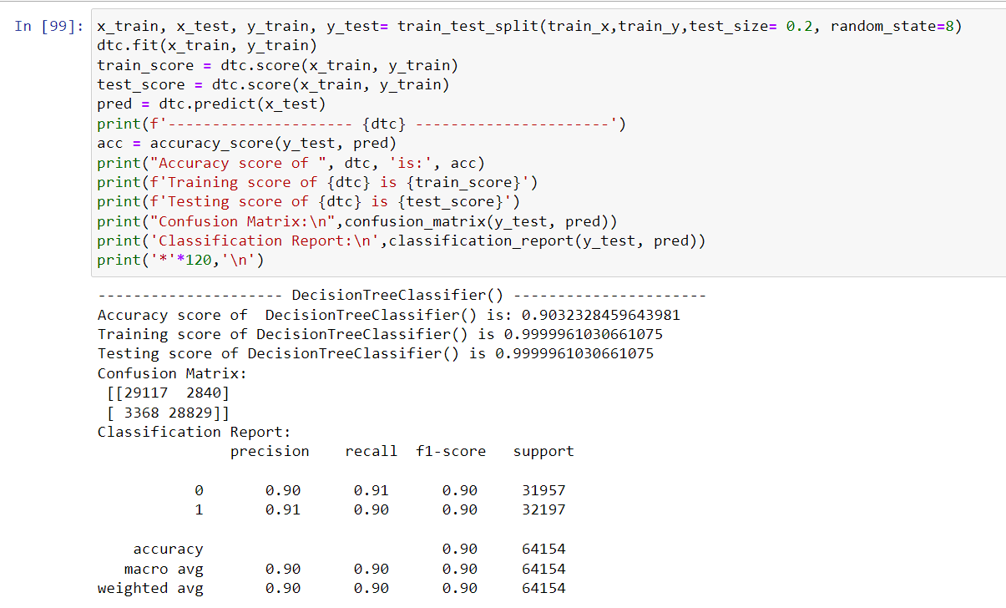
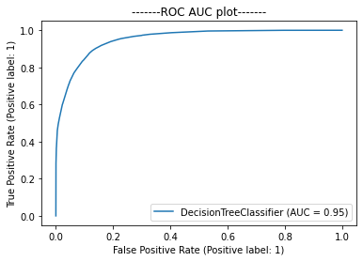
Predicted Original Total
1 1 28709
0 0 27846
1 0 4111
0 1 3488

Slide 7
Thank You

